Slide 1

AUTOMATED PARALYSIS PATIENT HEALTHCARE MONITORING SYSTEM USING IOMT THROUGH BLUETOOTH
.
TEAM MEMBERS:
BHARATH KRISHNAN S [210421121009]
GOKUL RAJ P [210421121015]
HEMANTH KUMAR R [210421121017]

Slide 2
PROBLEM STATEMENT
MAIN PROBLEM STATEMENTS
Paralysis of different muscles of the body can cause complications with other systems due to a lack of proper muscle function
The paralytic patients cannot be accompanied by others all the time and they are left alone
These people in most cases are not able to convey their needs as they are neither able to speak properly nor do they convey through sign language due to loss in motor control by their brain
They need the dependency of health Staff for their daily needs.

Slide 3
LITERATURE REVIEW
Sl. No | Title of the Paper | Authors | Name of the Journal, Year, Volume, Issue | Observation
1. | IOT based patient health monitoring system | D Shiva Rama Krishnan, Subhash Chand Gupta, Tanupriya Choudhury | An IoT-based Patient Health Monitoring System July 2018 | Nowadays Healthcare Environment has developed science and knowledge based on wireless sensing node Technology oriented.This is designed for monitoring patient’shealth and alerting.
2 | Patient monitoring system using GSM technology | Jaiee Sitaram Adivarkar | Patient monitoring system using GSM technology July 2017 | It is used to monitor the patient’s heart rate and temperature.
3 | Heart rate monitoring system using fingerprint through Arduino and processing software. | Bandana Mallick | Heart rate monitoring system using fingerprint through Arduino and processing software March 2017 | A measurement of heart rate through a tip and Arduino.

Slide 4
LITERATURE REVIEW
Sl. No44 | Title of the Paper | Authors | Name of the Journal, Year, Volume, Issue | Observation
4 | Sensor based Wearable system to assist paralytic patient with continuous health monitoring. | Kumara K R | Sensor based Wearable system to assist paralytic patient with continuous health monitoring | In extreme case of paralysis, the patient may be speech impaired which makes it difficult to convey the message.so this provides solutions to these inabilities.
5 | GSM based Paralysis Patient Monitoring System | Komal V. Sindagi1, Ragini B. Patil2, Rukkayya L. Mujawar3, M.B. Mulik4. | International Research Journal of Engineering and Technology (IRJET) e-ISSN: 2395-0056 Volume: 07 Issue: 06 | Automated Paralysis Patient Care System truly automates the care taking ability of the patient which ensures a timely attention to the patient and thus for a good health of the patient.
6 | Automated Paralysis Patient Monitoring System | Kaythrypandurangan, R.Vinu | Sri Sivasubramanya Nadar College of Engineering. Downloaded on December 01,2022 | In such a situation, our proposed system helps the disabled person in displaying a message over the LCD by simple motion of their hand. The proposed system works by reading the various tilt directions of the hand

Slide 5
LITERATURE REVIEW
Sl. No7 | Title of the Paper | Authors | Name of the Journal, Year, Volume, Issue | Observation
7 | Design and Implementation of Monitoring system for Paralysis patient using IoT | Fakeha Nasir Ahsan Sheikh Hira Beenish Muhammad Fahad | KIET Journal of Computing & Information Sciences [KJCIS] | Volume 4 | Issue 2 | Through this device paralyzed patient will be able to convey their messages to caretakers, so they can assist the patient timely. This system will enhance the medical care to those patients who are even not able to convey their message because of paralysis condition.
8 | Paralyzed Patient Monitoring Equipment -IoT | Avinash Wilson Vincy Vv | ISSN (ONLINE):2456-5717 Vol.6, Issue.10, October 2020 | The proposed system is to monitor a paralyzed patient's pulse rate and their hand movements to notify the status of the patient to the Care-Taker. The system includes a mobile application for the Patient and Care-Taker.
9 | iot Based Embedded System for Continuous Healthcare Monitoring | M.Thilagaraj, R.Krishnakumar, S.Kiruthika, K.Meena, S.Hari Bala | Annals of R.S.C.B., ISSN:1583-6258, Vol. 25, Issue 4, 2021, Pages. 4420 - 4424 Received 05 March 2021; Accepted 01 April 2021 | This system is responsible for collecting pulse, body temperature and heart bit from the patient’s body and send the data into IoT Cloud platform by using WIFI-Module and health condition of patient stored in the cloud

Slide 6
LITERATURE REVIEW
Sl. No | Title of the Paper | Authors | Name of the Journal, Year, Volume, Issue | Observation
10 | Secured Smart Healthcare Monitoring System Based on Iot |  | International Journal on Recent and Innovation Trends in Computing and Communication ISSN: 2321-8169 Volume: 3 Issue: 7 4958 - 4961 | Hence quick provisional medication can be easily done by this system. This system is efficient with low power consumption capability, easy setup, high performance and time to time response.
11 | IoT-Based Healthcare-Monitoring System towards Improving Quality of Life: A Review | Suliman Abdulmalek , Abdul Nasir , WahebA. Jabbar , Mukarram | S.-H. IoT-Based HealthcareMonitoring System towards Improving Quality of Life: A Review. Healthcare 2022, 10, 1993. | w. The literature review compares various systems’ effectiveness, efficiency, data protection, privacy, security, and monitoring. The paper also explores wireless- and wearable-sensorbased IoT monitoring systems and provides a classification of healthcare-monitoring sensors.

Slide 7
EXISTING SYSTEM
The project used the technology in telecommunication, where the evolution in telecommunication was applied in this project by using GSM module SIM900A.
At the same time, a few circuit and software are used to be a controller for all the main and sub equipment.
A few components like microcontroller and GSM module are used. By using the gesture sensor, it will aid the patient to convey anything that they want through the GSM module by sending message.
The function of this sensor is that the patient just needs to move the body part to which the sensor is attached to convey a message.
Besides this, the data will be displayed at the LED screen to know what the patient want to convey. On the other hand, the buzzer will sound when there is any emergency case and the SMS alert will be sent to the care taker of the patient. The main aim of this project is to help paralyzed patient to convey their message or need.

Slide 8
PROPOSED SYSTEM
In the new proposed system, we intend to enhance the existing setup by integrating Bluetooth technology and audio communication.
Building upon the telecommunication foundation, we will employ Bluetooth connectivity to establish a seamless link between the patient and caregivers.
Instead of relying solely on text messages, this system will enable patients to communicate through audio, adding a more natural and expressive dimension to their interactions.
Patients can now articulate their needs verbally, which will be transmitted via Bluetooth to a dedicated device monitored by caregivers .

Slide 9
WORKING
A paralysis patient healthcare monitoring system using Arduino and ESP8266 is designed to continuously monitor and provide care for patients with paralysis.
1. Sensor Integration:
- Various sensors, such as accelerometers, temperature sensors, heart rate sensors, and pressure sensors, are integrated into the system.
2. Data Collection:
- The sensors continuously collect data, including vital signs, body movements, and environmental conditions.
3. Wireless Communication:
- The ESP8266 module is used to establish a wireless connection to the internet or a local network.
4. Data Transmission:
- The data is transmitted in real-time to a designated server or the caregiver's device using Wi-Fi or other internet connectivity.
5. Data Analysis:
- The data received on the remote server or caregiver's device is analyzed to detect any abnormalities or critical changes in the patient's health status.
6. Alert System:
- If the system detects a critical condition or an emergency, it triggers an alert.

Slide 10
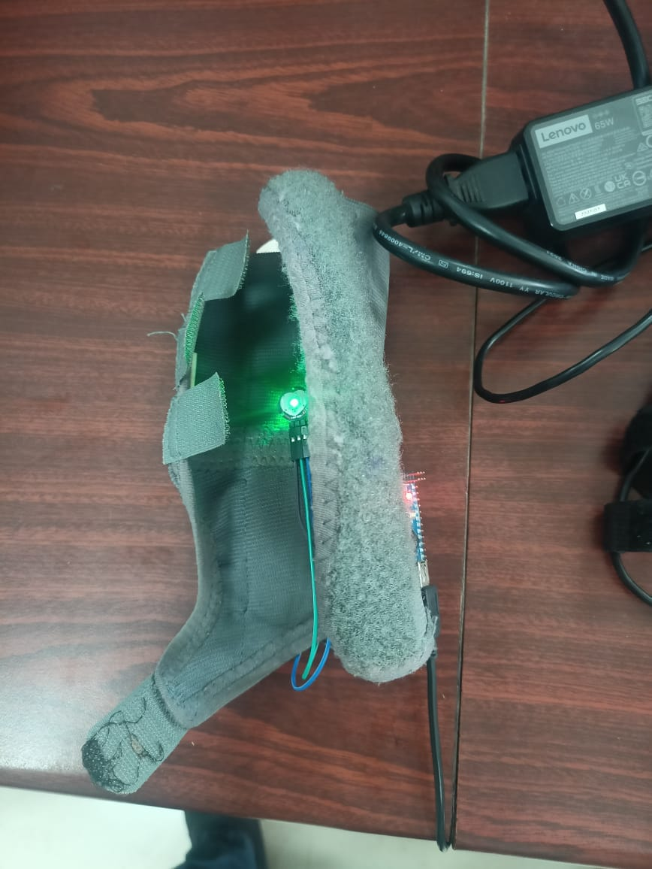
PHOTOSNAP OF PROJECT

Slide 11
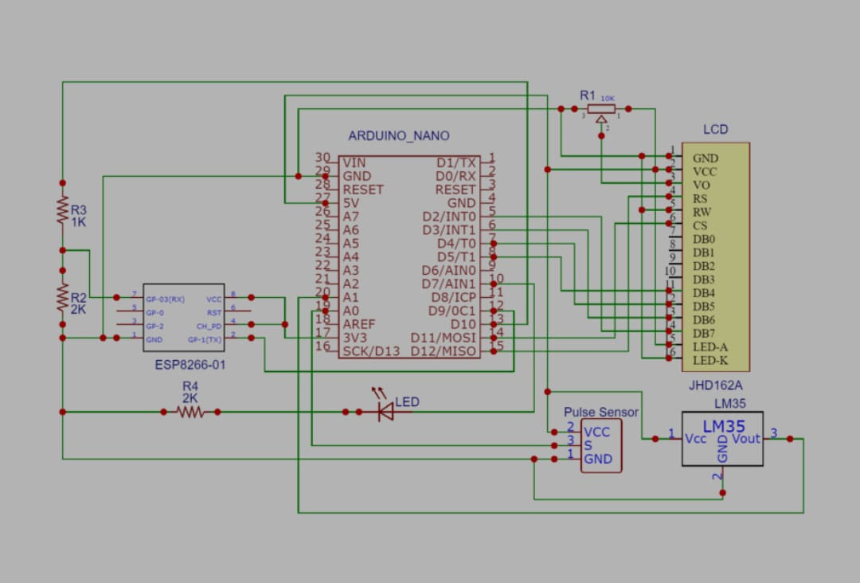
CIRCUIT DIAGRAM

Slide 12
WORKING VIDEO OF PROJECT
https://drive.google.com/

Slide 13
RESULT AND DISCUSSION
Described about the system successfully collected essential healt data from the paralysis patient ,such as heart rate,body temperature and motion sensor data.
Discussed about the reliability and accuracy of data transmission using the ESP8266 emphasizing low latency and high data integrity.
It Highlights the systems ability to provide real time monitoring of the patients health parameters,enabling timely interventions and reducing the risk of complications.
Discuss how healthcare providers or caregivers can remotely access the patients’s data web interface ,smartphone app, or other means.
Mention any feedback or usability testing reults that support the systems’s ease of use.

Slide 14
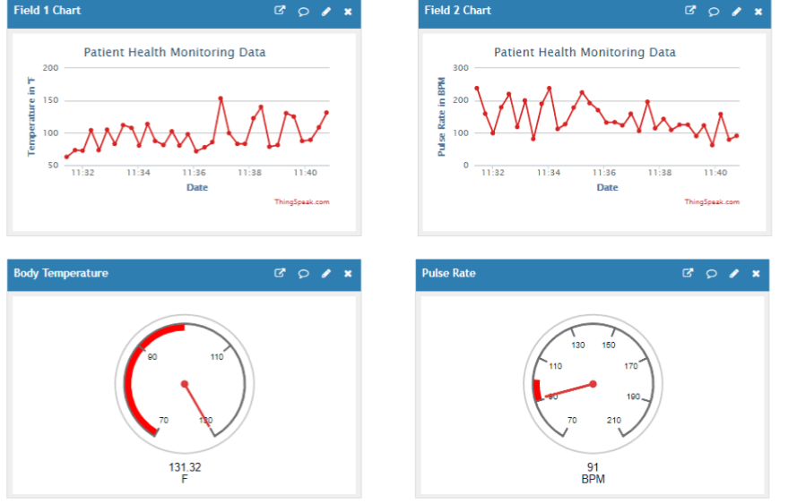
GRAPH

Slide 15
APPLICATION
Fall Detection and Prevention: Bluetooth sensors can detect sudden changes in a patient's position or movements, helping to identify potential falls.
Alerts can be sent to caregivers or medical professionals, allowing for immediate assistance.
Medication Management: Bluetooth-enabled pill dispensers can remind patients to take their medications at the prescribed times.
Caregivers can also receive notifications if medications are not taken on schedule.
Activity Tracking: Sensors can monitor a patient's physical activity, such as daily steps and movement patterns.
This data can be used to encourage mobility and provide insights into a patient's overall health.

Slide 16
FUTURE WORK
Enhanced Wearable Devices
Biomechanical Feedback and Support
Artificial Intelligence and Machine Learning:
Telemedicine Integration.
Brain-Computer Interfaces (BCIs)
Predictive Analytics
Sensor Miniaturization:

Slide 17
Reference
[1]“Automated Paralysis Patient Health Care Monitoring System” published in the South Asian Journal of Engineering and Technology Vol.3, No.2 (2017) 85–92 .
[3]M. S. Hossain, ‘‘Patient state recognition system for healthcare using speech and facial expressions,’’ J. Med. Syst., vol. 40, p. 272, Dec. 2016.
S. Kumar and S. K. Singh, ‘‘Monitoring of pet animal in smart cities using animal biometrics,’’ Future Generat. Comput. Syst., to be published.

Slide 18


